Slide 1

Varendra University
Dept. of Computer Science & Engineering (CSE)
Addressing Mode and Mathematical Calculation
Course Title: Microprocessor and Assembly Language
Course No: CSE 3205
Prepared By:
Md. Adnan Sami
Lecturer, Dept. of CSE, VU

Slide 2
Outline
  Addressing Mode.
  Memory Segmentation.
  Segment and Offset.
  Physical Address and Logical Address Calculation.
  Address Line and Data Line Calculation.

Slide 3
Addressing Mode
  The manner in which operand is given an instruction is called addressing mode.
  Example:
  MOV AX, BX
  Opcode Operand
  MOV
  ADD Opcode (Operation)
  SUB

Slide 4
Addressing Mode
  The manner in which operand is given an instruction is called addressing mode.
  i) Immediate mode: Data is given in instruction.
  MOV AL, 25H
  MOV BX, 2000H
  ii) Register mode: Data is given in register.
  MOV AL, BL
  MOV AX, BX
  iii) Direct mode: Address is given in instruction.
  MOV AX, [2000H]
  iv) Indirect mode: Address is given in register.
  MOV AL, [BX]

Slide 5
Addressing Mode
  Indirect mode:
  Register mode:
  Physical address = Segment address + Effective address
  MOV AL, [BX]
  Base indexed:
  Effective address = Base register + Index register
  Base register = BX, BP
  Index register = SI, DI
  MOV AX, [BX+SI]
  MOV AL, [BP+SI]

Slide 6
Addressing Mode
  Indirect mode:
  Indexed mode:
  Effective address = Index register + Displacement
  MOV AX, [SI+2000]
  Base mode:
  Effective address = Base register + Displacement
  MOV AL, [BP+2000]

Slide 7
Addressing Mode
  Indirect mode:
  Base indexed displacement:
  Effective address = Index register + Base register + Displacement
  MOV AL, [SI+ BP+ 2000]

Slide 8
Memory Segmentation
  Segmentation is the process in which the main memory of the computer is logically divided into different segments.
  Total memory size is divided into segments of various sizes is called memory segmentation.
  It helps in organizing and managing memory efficiently.
  Advantage
    Efficient Memory Utilization.
    Protection.
    Faster Execution.

Slide 9
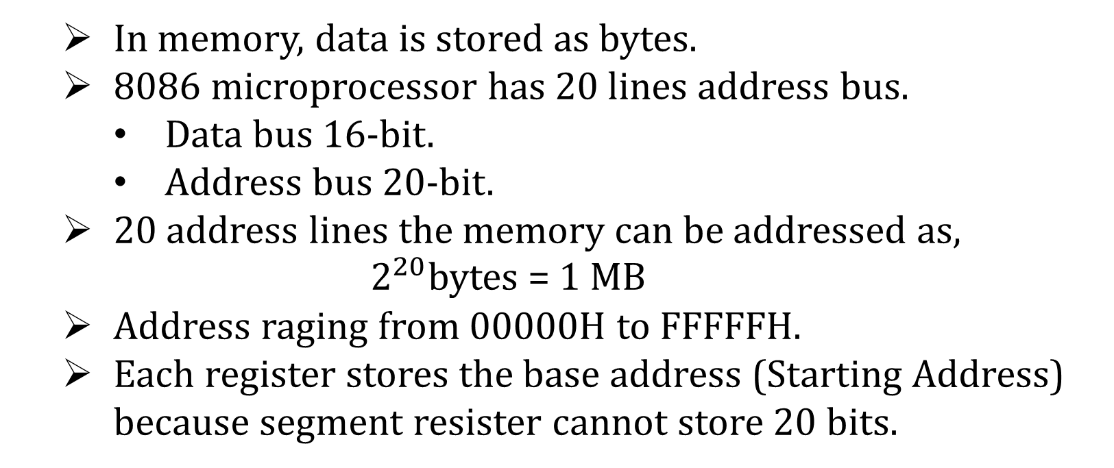
Memory Segmentation
  In memory, data is stored as bytes.
  8086 microprocessor has 20 lines address bus.
    Data bus 16-bit.
    Address bus 20-bit.
  20 address lines the memory can be addressed as,
  $2^{20}$bytes = 1 MB
  Address raging from 00000H to FFFFFH.
  Each register stores the base address (Starting Address) because segment resister cannot store 20 bits.

Slide 10
Segment and Offset
  Memory address is specified using two components,
  Segment: Identifies the starting location (base address).
  Offset: Specifies the position within that segment.
  8086 has 4 different types of segment,
    Code Segment (CS).
    Data Segment (DS).
    Stack Segment (SS).
    Extra Segment (ES).
  16-bit

Slide 11
Segment and Offset
Segment | Offset
CS | IP
DS | BX, DI, SI
SS | SP, BP
ES | DI

Slide 12
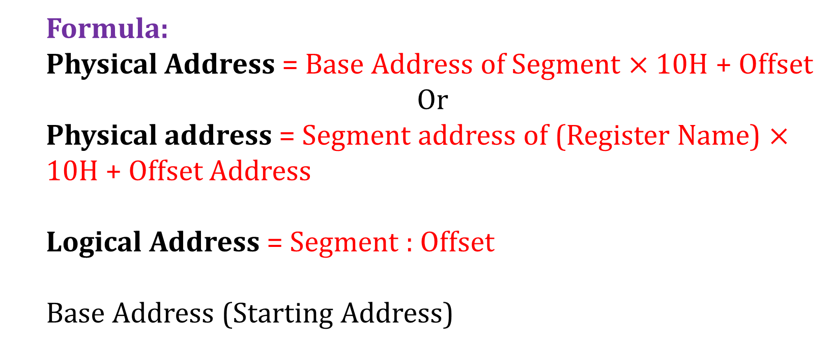
Physical Address and Logical Address Calculation
  Formula:
  Physical Address = Base Address of Segment $×$ 10H + Offset
  Or
  Physical address = Segment address of (Register Name) $×$ 10H + Offset Address
  Logical Address = Segment : Offset
  Base Address (Starting Address)

Slide 13
Physical Address and Logical Address Calculation
  Problem 1:
  The content of following registers are,
  CS = 1111H DS = 1678H SS = 6789H ES = 1298H
  IP = 6721H BX = 7865H DI = 1235H BP = 7821H
  Calculate the corresponding physical and logical address from address bytes in CS, DS, SS & ES.
  Solution:
  Segment: CS, DS, SS, ES
  Offset: IP, BP, DI, BX

Slide 14
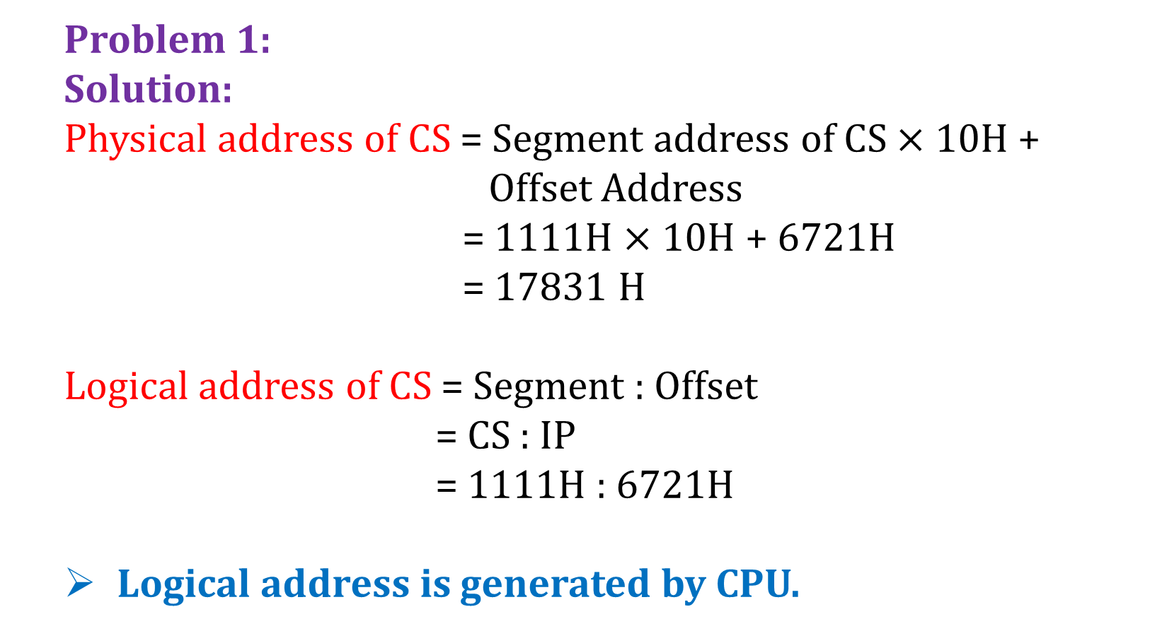
Physical Address and Logical Address Calculation
  Problem 1:
  Solution:
  Physical address of CS = Segment address of CS $×$ 10H + Offset Address
  = 1111H $×$ 10H + 6721H
  = 17831 H
  Logical address of CS = Segment : Offset
  = CS : IP
  = 1111H : 6721H
  Logical address is generated by CPU.

Slide 15
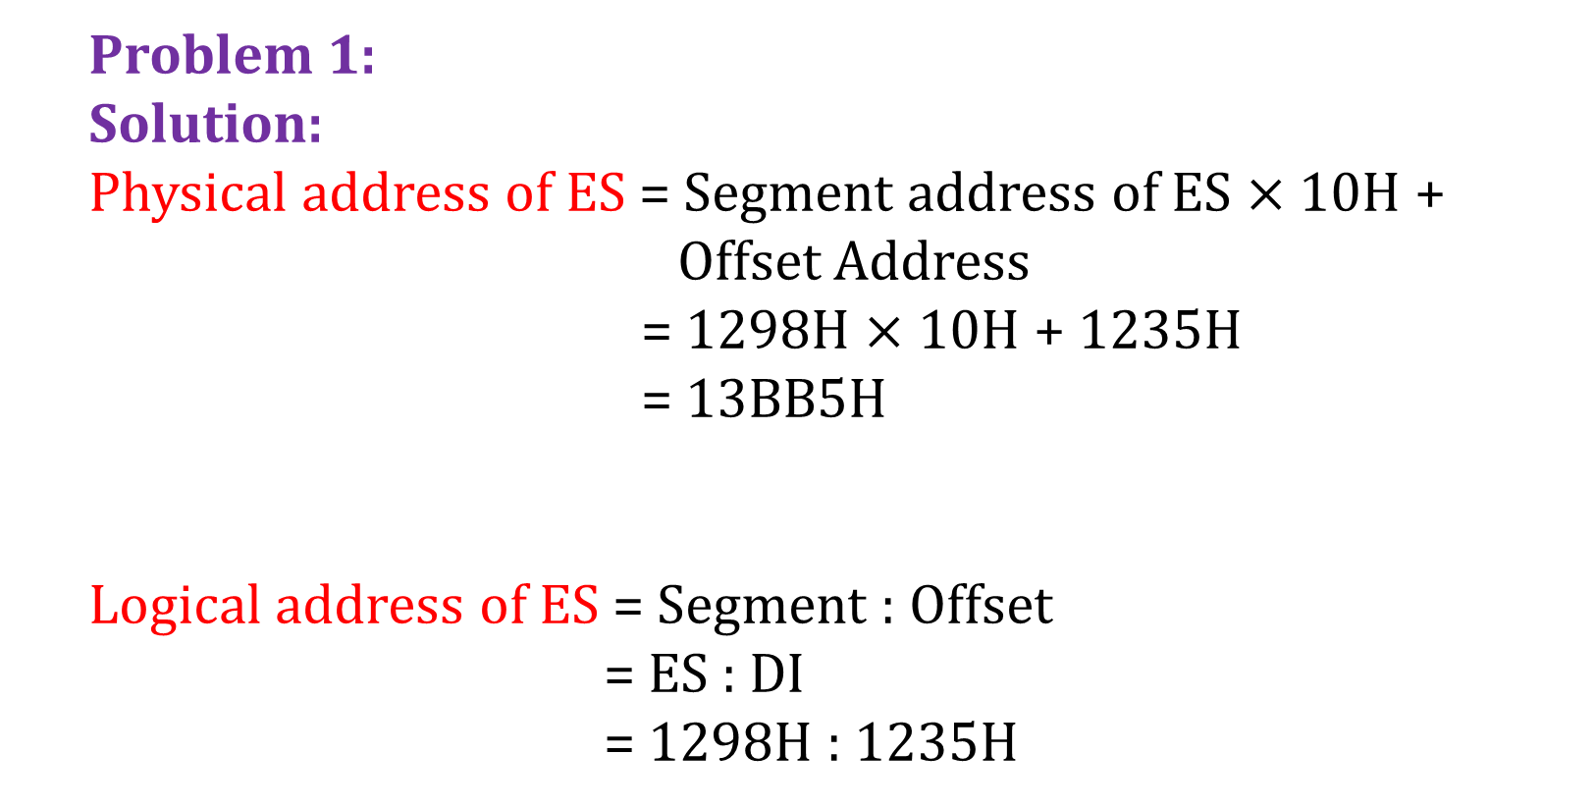
Physical Address and Logical Address Calculation
  Problem 1:
  Solution:
  Physical address of ES = Segment address of ES $×$ 10H + Offset Address
  = 1298H $×$ 10H + 1235H
  = 13BB5H
  Logical address of ES = Segment : Offset
  = ES : DI
  = 1298H : 1235H
  1 2 9 8 0
  1 2 3 5
  1 3 B B 5

Slide 16
Physical Address and Logical Address Calculation
  Problem 1:
  Physical address and Logical address of DS and SS.
Try Yourself

Slide 17
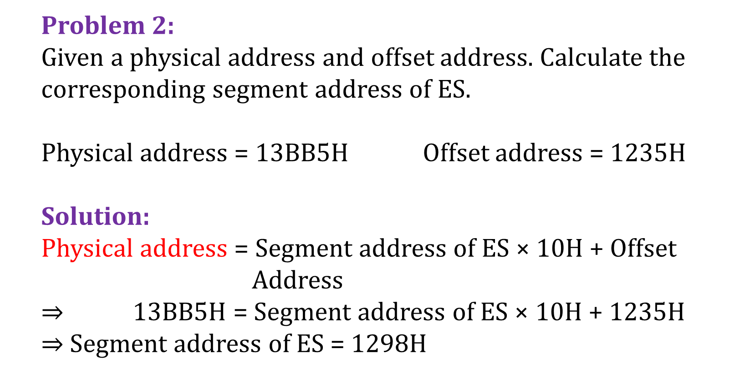
Physical Address and Logical Address Calculation
  Problem 2:
  Given a physical address and offset address. Calculate the corresponding segment address of ES.
  Physical address = 13BB5H Offset address = 1235H
  Solution:
  Physical address = Segment address of ES × 10H + Offset Address
  $⇒$ 13BB5H = Segment address of ES × 10H + 1235H
  $⇒$Segment address of ES = 1298H

Slide 18
Physical Address and Logical Address Calculation
  Problem 3:
  Calculate the physical address for following register.
  SS = 3864H SP = 1735H BP = 4826H
  Solution:
  Case 1:
  Physical address = Segment address of SS × 10H + Offset Address (SP)
  = 3864H × 10H + 1735H
  = 39D75H

Slide 19
Physical Address and Logical Address Calculation
  Problem 3:
  Calculate the physical address for following register.
  SS = 3864H SP = 1735H BP = 4826H
  Solution:
  Case 2:
  Physical address = Segment address of SS × 10H + Offset Address (BP)
  = 3864H × 10H + 4826H
  = 3CE66H

Slide 20
Physical Address and Logical Address Calculation
  Problem 4:
  Calculate the physical address for following instruction.
  DS = 1000H SS = 7000H ES = 4000H
  BP = 0100H SI = 0020H DI = 0200H BX = 0700H
  Value (Displacement = 0500H)
  Solution:
  i) MOV AX, [BX][SI]
  Physical address = Segment address of DS × 10H + [BX+SI]
  = 1000H × 10H + [0700H+0020H]
  = 10720H
  Offset BX, SI = DS

Slide 21
Physical Address and Logical Address Calculation
  Problem 4:
  Calculate the physical address for following instruction.
  DS = 1000H SS = 7000H ES = 4000H
  BP = 0100H SI = 0020H DI = 0200H BX = 0700H
  Value (Displacement = 0500H)
  Solution:
  ii) ADD AL, (BP+40H)
  Physical address = Segment address of SS × 10H + (BP+40H)
  = 7000H × 10H + (0100H+40H)
  = 70140H
  Offset BP = SS

Slide 22
Physical Address and Logical Address Calculation
  Problem 4:
  Calculate the physical address for following instruction.
  DS = 1000H SS = 7000H ES = 4000H
  BP = 0100H SI = 0020H DI = 0200H BX = 0700H
  Value (Displacement = 0500H)
  Solution:
  iii) MOV CX, Values[BP]
  Physical address = Segment address of SS × 10H + [BP + Values]
  = 7000H × 10H + (0100H+0500H)
  = 70600H
  Offset BP = SS

Slide 23
Physical Address and Logical Address Calculation
  Problem 4:
  Calculate the physical address for following instruction.
  DS = 1000H SS = 7000H ES = 4000H
  BP = 0100H SI = 0020H DI = 0200H BX = 0700H
  Value (Displacement = 0500H)
  Solution:
  iv) MOV ES:[1000H], AL
  Physical address = Segment address of ES × 10H + [1000H] = 4000H × 10H + [1000H]
  = 41000H

Slide 24
Physical Address and Logical Address Calculation
  Problem 5:
  Logical address is 8000H : 0000H. Calculate the physical address.
  Solution:
  Physical address = Segment address × 10H + Offset = 8000H × 10H + 0000H
  = 80000H

Slide 25
Physical Address and Logical Address Calculation
  Problem 6:
  What is the physical address of 6th segment for location 250?
  Solution:
  Segment = 5000H (Segment starts from 0. So, 5)
  Offset = 249 (Start from 0. So, 249)
  = 00F9H (Hexadecimal value)
  Physical address = Segment address × 10H + Offset = 5000H × 10H + 00F9H
  = 500F9H

Slide 26
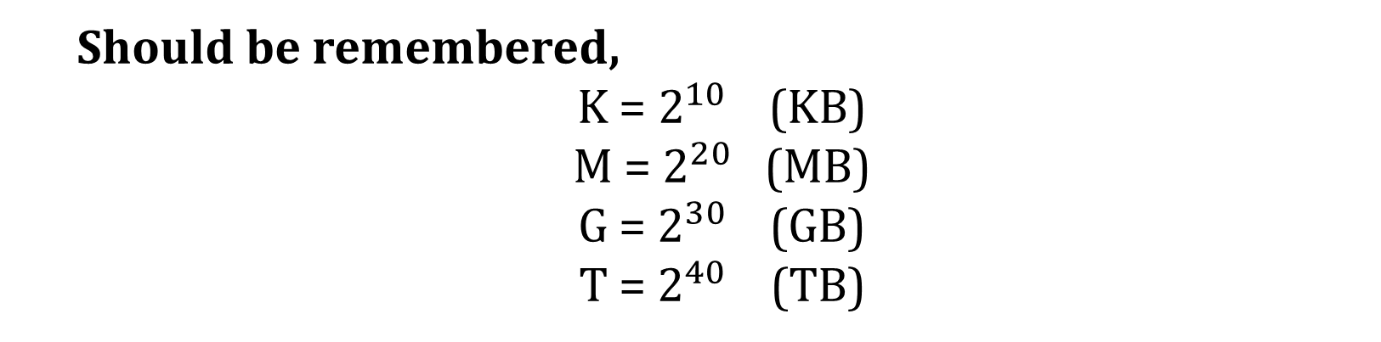
Address Line and Data Line Calculation
  Should be remembered,
  K = $2^{10}$ (KB)
  M = $2^{20}$ (MB)
  G = $2^{30}$ (GB)
  T = $2^{40}$ (TB)

Slide 27
Address Line and Data Line Calculation
  The memory units that follows are specified by the number of words times, the number of bits per word. How many address lines and input output data lines are needed in each case?
  a) 8K × 16 b) 2G × 8 c) 16M × 32
  d) 256K × 64 e) 64K × 8 f) 2T × 8
  Solution:
  8K × 16
  Word Bit
  Data line is obtained from “bit value”
  Address line is obtained from “Word value”

Slide 28
Address Line and Data Line Calculation
  The memory units that follows are specified by the number of words times, the number of bits per word. How many address lines and input output data lines are needed in each case?
  a) 8K × 16 b) 2G × 8 c) 16M × 32
  d) 256K × 64 e) 64K × 8 f) 2T × 8
  Solution:
  Let, address line is denoted by “A” and data line is denoted by “D”.

Slide 29
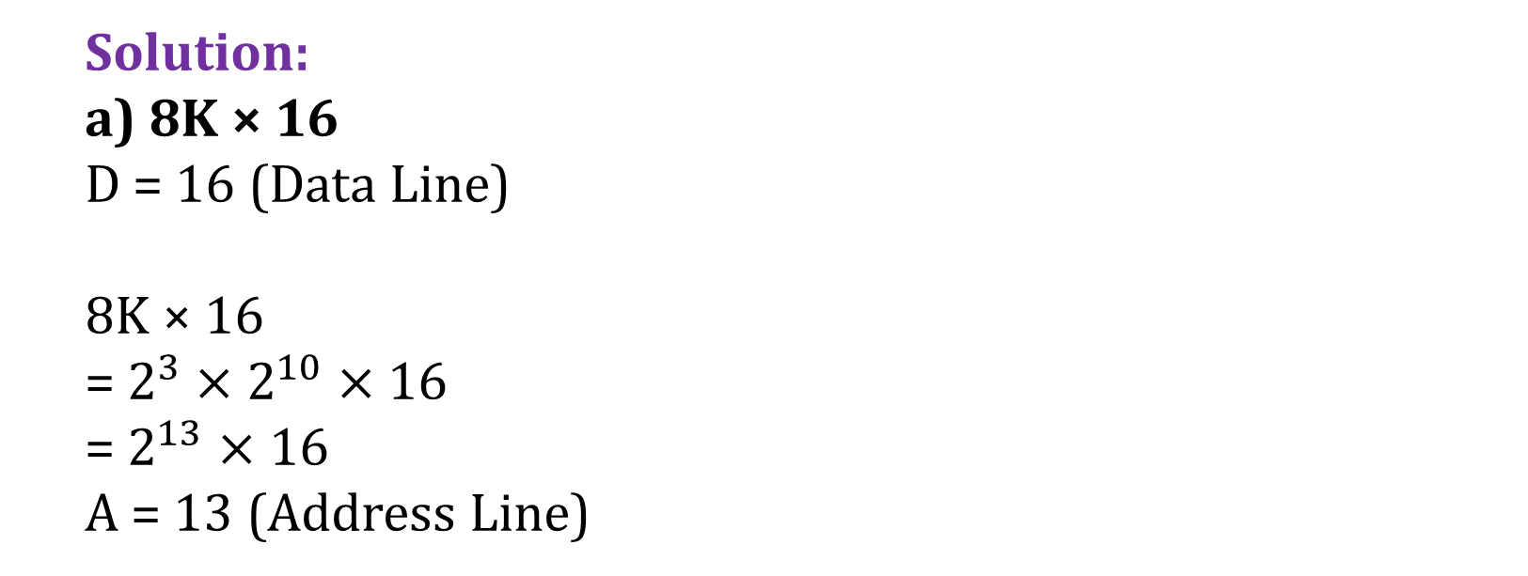
Address Line and Data Line Calculation
  Solution:
  a) 8K × 16
  D = 16 (Data Line)
  8K × 16
  = $2^{3}×$ $2^{10}$ $×$ 16
  = $2^{13}$ $×$ 16
  A = 13 (Address Line)

Slide 30

Address Line and Data Line Calculation
  Solution:
  b) 2G × 8
  D = 8 (Data Line)
  2G × 8
  = $2^{1}×$ $2^{30}$ $×$ 8
  = $2^{31}$ $×$ 8
  A = 31 (Address Line)

Slide 31

Address Line and Data Line Calculation
  Solution:
  c) 16M × 32
  D = 32 (Data Line)
  16M × 32
  = $2^{4}×$ $2^{20}$ $×$ 32
  = $2^{24}$ $×$ 32
  A = 24 (Address Line)

Slide 32
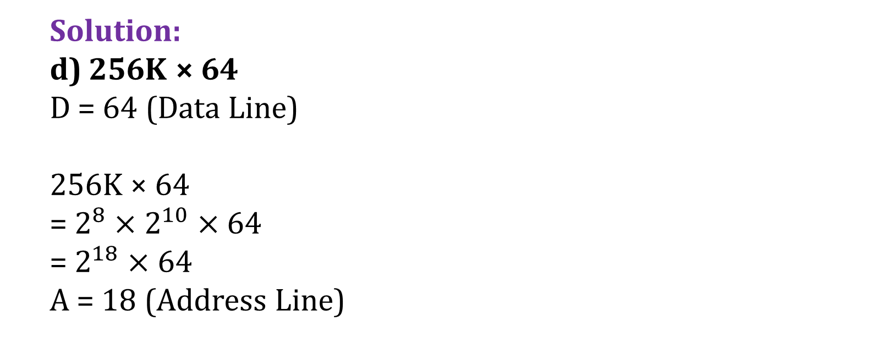
Address Line and Data Line Calculation
  Solution:
  d) 256K × 64
  D = 64 (Data Line)
  256K × 64
  = $2^{8}×$ $2^{10}$ $×$ 64
  = $2^{18}$ $×$ 64
  A = 18 (Address Line)

Slide 33

Address Line and Data Line Calculation
  Solution:
  e) 64K × 8
  D = 8 (Data Line)
  64K × 8
  = $2^{6}×$ $2^{10}$ $×$ 8
  = $2^{16}$ $×$ 8
  A = 16 (Address Line)

Slide 34

Address Line and Data Line Calculation
  Solution:
  f) 2T × 8
  D = 8 (Data Line)
  2T × 8
  = $2^{1}×$ $2^{40}$ $×$ 8
  = $2^{41}$ $×$ 8
  A = 41 (Address Line)

